Slide 1
Risk for AD

Slide 2

model
$R\left(X_{i}, t_{i}\right)=β_{0}+ β_{1}X_{i}+f\left(t_{i}\right)+ ε_{r}$
$R\left(X_{i}, t_{i}\right) =log⁡(\frac{p\left(y_{i,t_{i}}=1\right)}{1−p\left(y_{i,t_{i}}=1\right)})$
$\hat{\left(β_{0},β_{1},α_{1},…,α_{k}\right)}= argmin_{β_{0},β_{1},α_{0},…,α_{k}} l\left(\hat{y},y\right)+λ{\left\|\left(β_{1}\right)\right\|}_{1}+γ{\left\|\left(α_{1},…,α_{k}\right)\right\|}_{1}$
$l\left(\hat{Y},Y\right)=\frac{1}{n}∑\left(1−y_{i}\right)log⁡(1−\hat{y_{i}})−y_{i}log⁡(1−\hat{y_{i}})$ and $Y=(y_{1}, …, y_{n})$

Slide 3
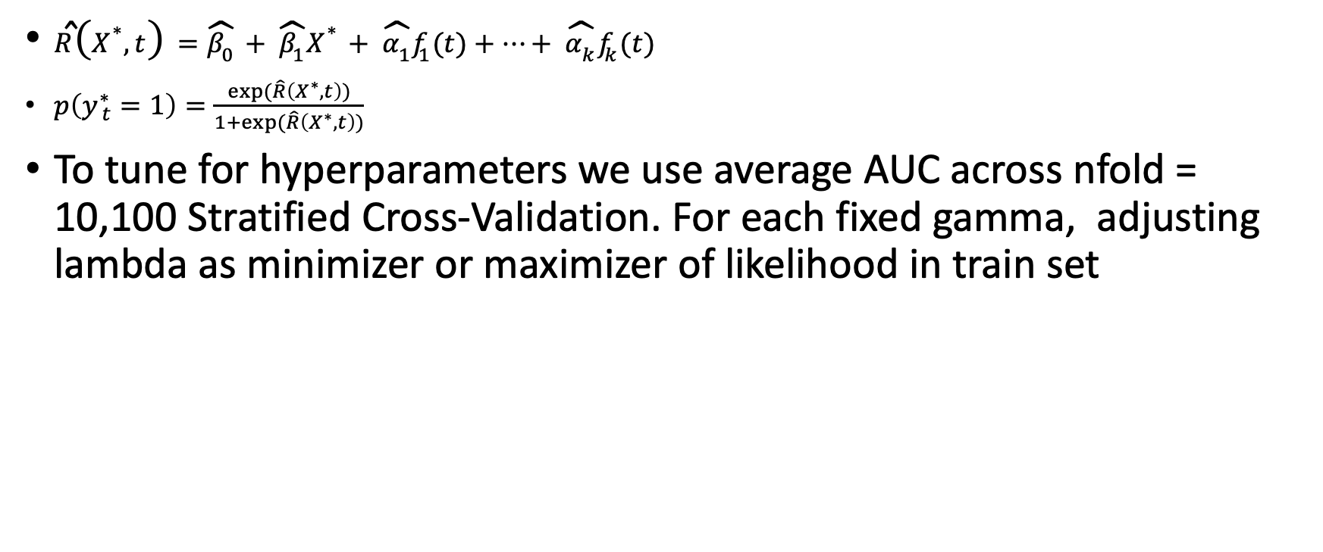
estimation
$\hat{R}\left(X^{∗}, t\right)=\hat{β_{0}}+ \hat{β_{1}}X^{∗}+ \hat{α_{1}}f_{1}(t)+…+ \hat{α_{k}}f_{k}(t)$
$p\left(y_{ t}^{∗}=1\right)=\frac{exp(\hat{R}\left(X^{∗}, t\right))}{1+exp⁡(\hat{R}\left(X^{∗}, t\right))}$
To tune for hyperparameters we use average AUC across nfold = 10,100 Stratified Cross-Validation. For each fixed gamma, adjusting lambda as minimizer or maximizer of likelihood in train set

Slide 4
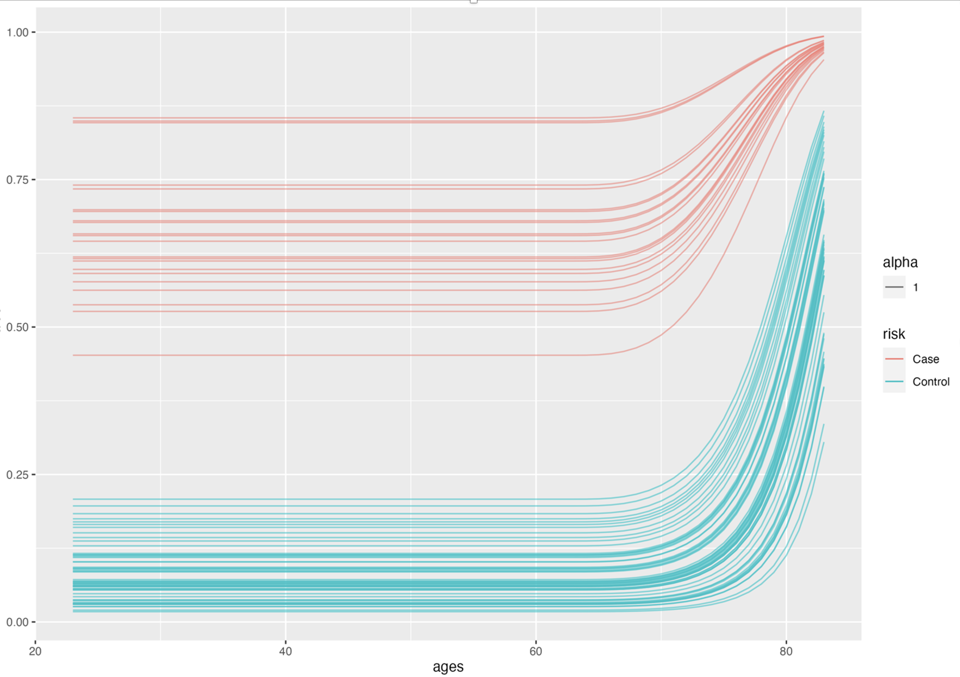
Results with 85 subjects (22 mci+ad)
SubNetwork | Region Number | Region Name | SubNetwork Weight | SubNetwork Average of reduced sum
1 | 5, 7 | Left Pallidum, Left Amygdala | 0.0034 | 0.0034
2 | 1, 15, 43, 63, 82 | Left Cerebellum-Cortex, Right Amygdala, Left superiorfrontal, Right medialorbitofrontal, Right temporalpole | 0.0310 | 0.0310
3 | 8, 26 | Left Accumbens-area, Left lateraloccipital | 0.0039 | 0.0039
4 | 32, 37 | Left paracentral, Left postcentral | -0.0004 | 0.0004
5 | 13, 60, 39, 74, 77 | Right Pallidum, Right lateraloccipital, Left precentral, Right precuneus, Right superiorfrontal | 0.0314 | 0.0314
6 | 34, 45 | Left parsorbitalis, Left superiortemporal | -0.0031 | 0.0031
7 | 25, 50, 76 | Left isthmuscingulate, Left insula, Right rostralmiddlefrontal | 0.0051 | 0.0364
8 | 20, 54 | Left cuneus, Right cuneus | 0.0049 | 0.0049
9 | 3, 56, 57 | Left Caudate, Right fusiform, Right inferiorparietal | -0.1575 | 0.1575
10 | 40, 61 | Left precuneus, Right lateralorbitofrontal | -0.0050 | 0.0050
11 | 64, 65, 70 | Right middletemporal, Right parahippocampal, Right pericalcarine | 0.0045 | 0.0045
12 | 71, 73 | Right postcentral, Right precentral | 0.0004 | 0.0004
13 | 6, 75 | Left Hippocampus, Right rostralanteriorcingulate | -0.0255 | 0.0255
14 | 58, 78 | Right inferiortemporal, Right superiorparietal | 0.0004 | 0.0004

Slide 5
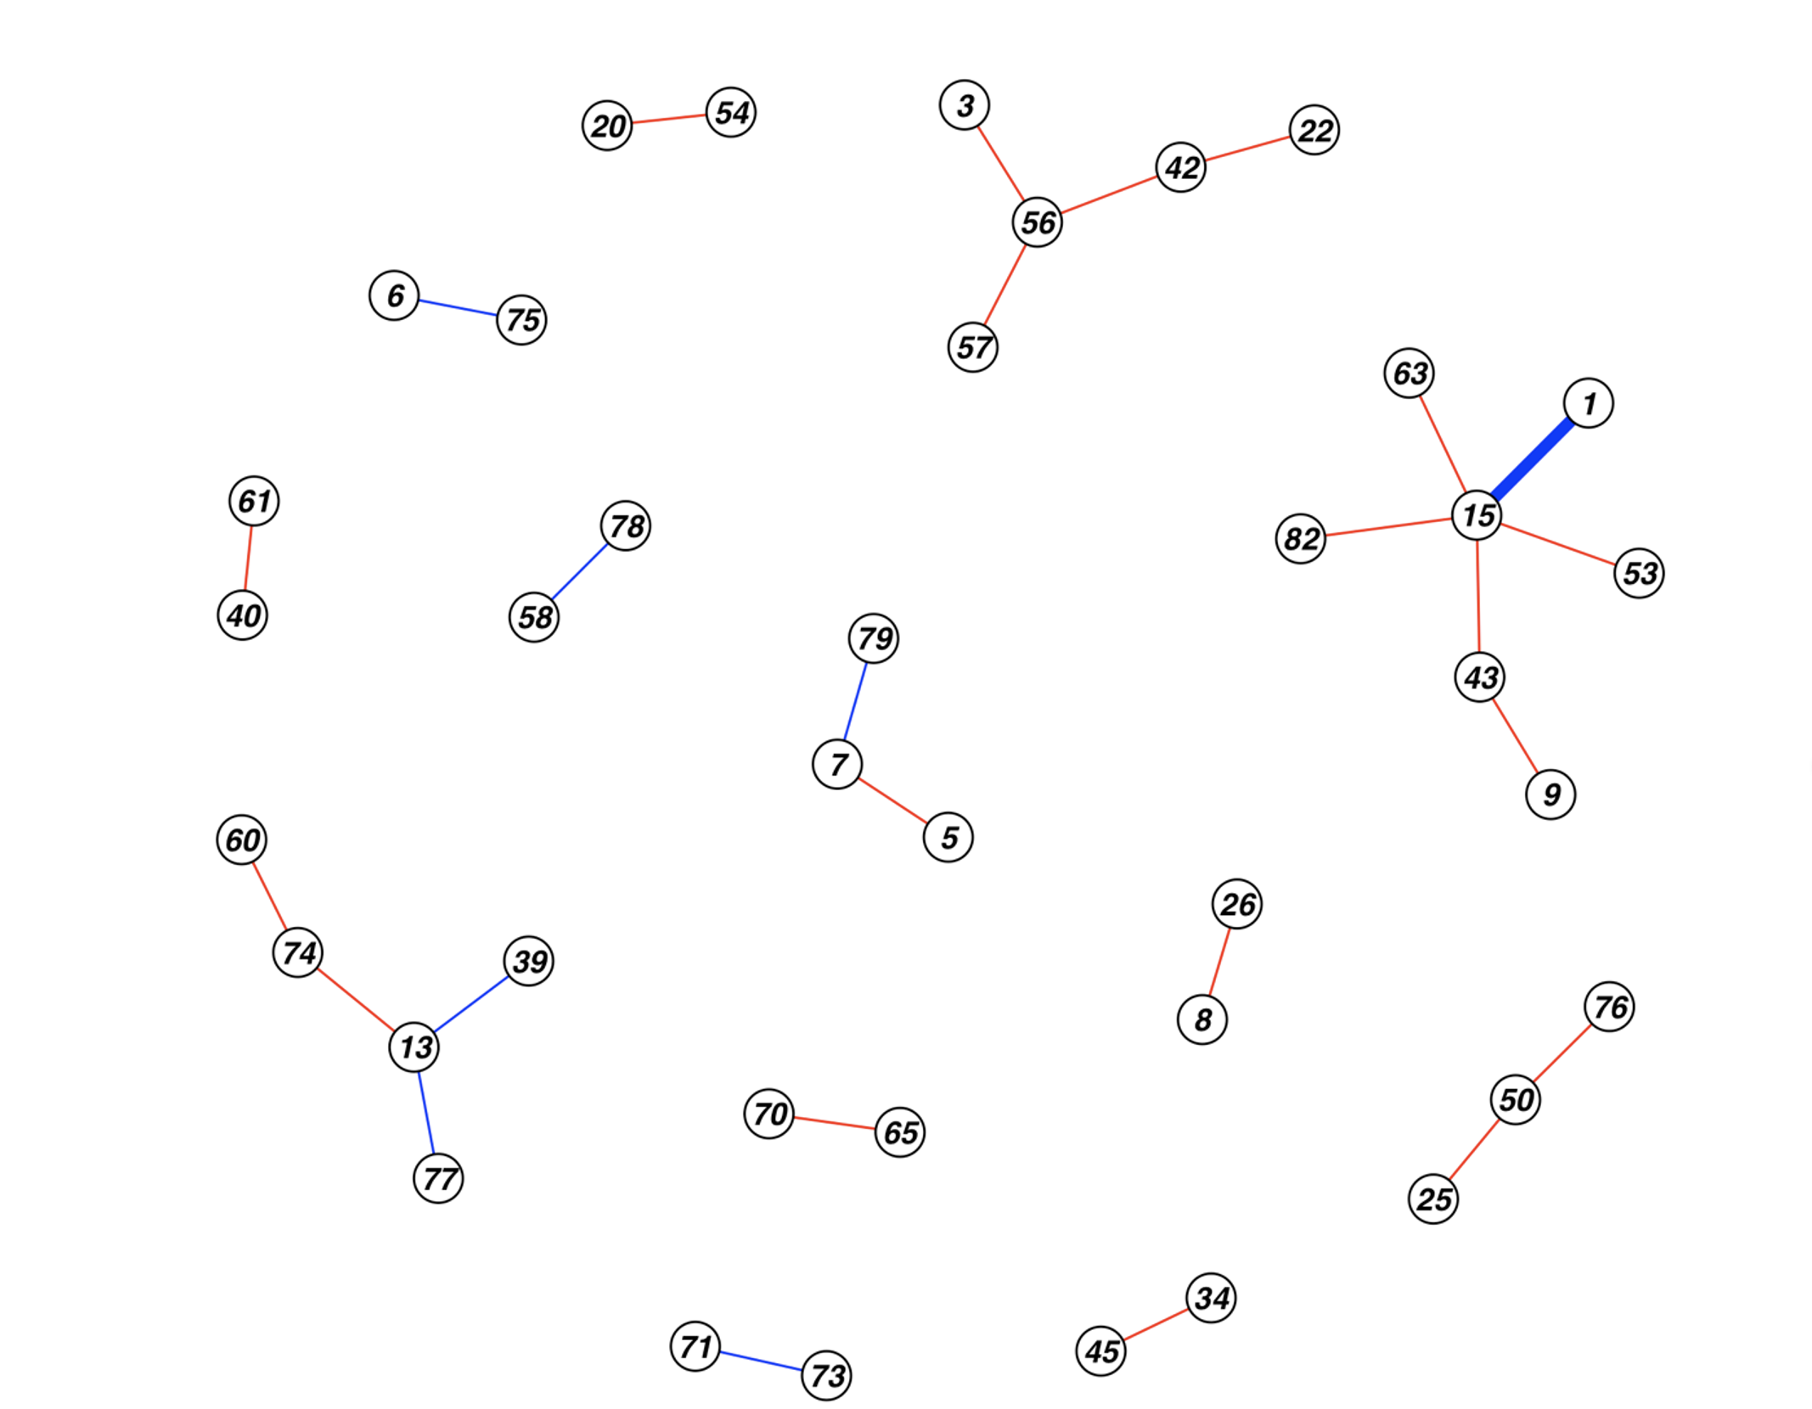
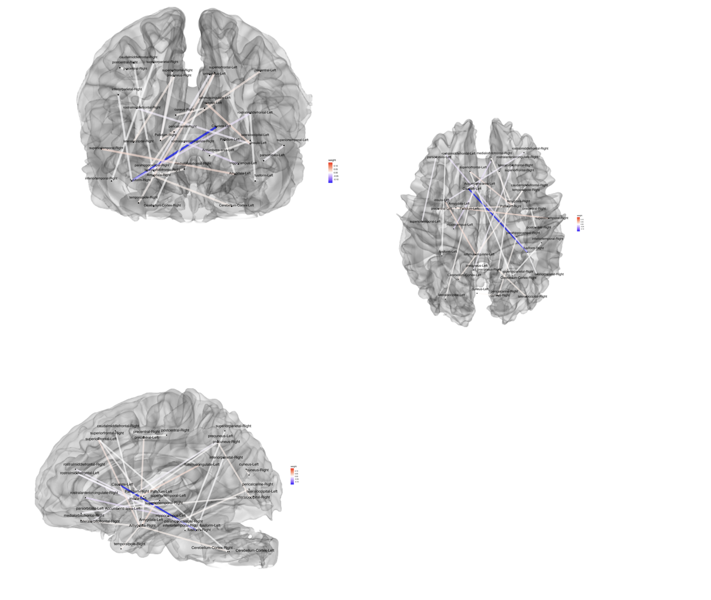
network results

Slide 6
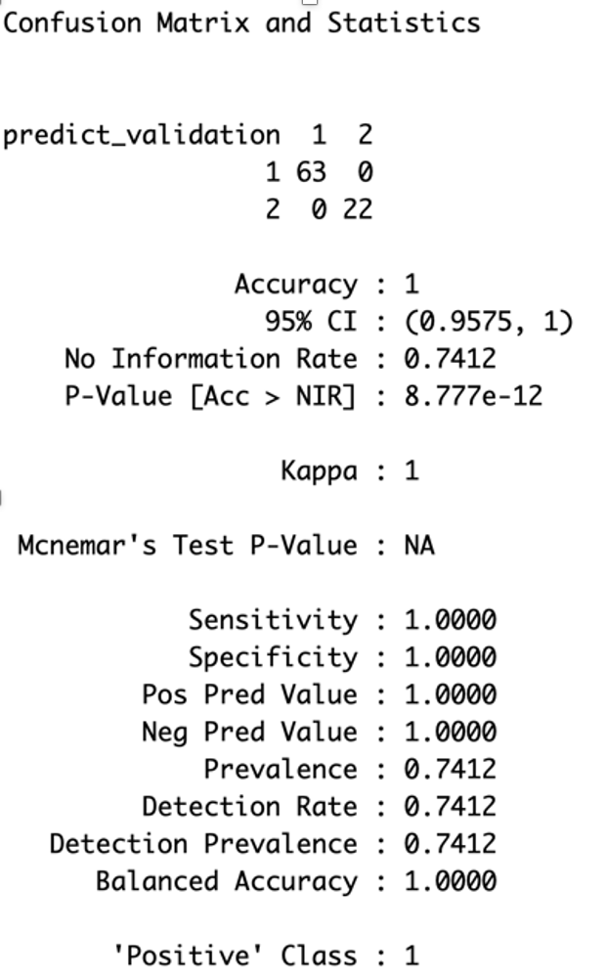
The area under the curve is 1, and the confusion matrix on the final regression shows a promising result of Sensitivity = 1.0000 and Specificity= 1.0000

Slide 7
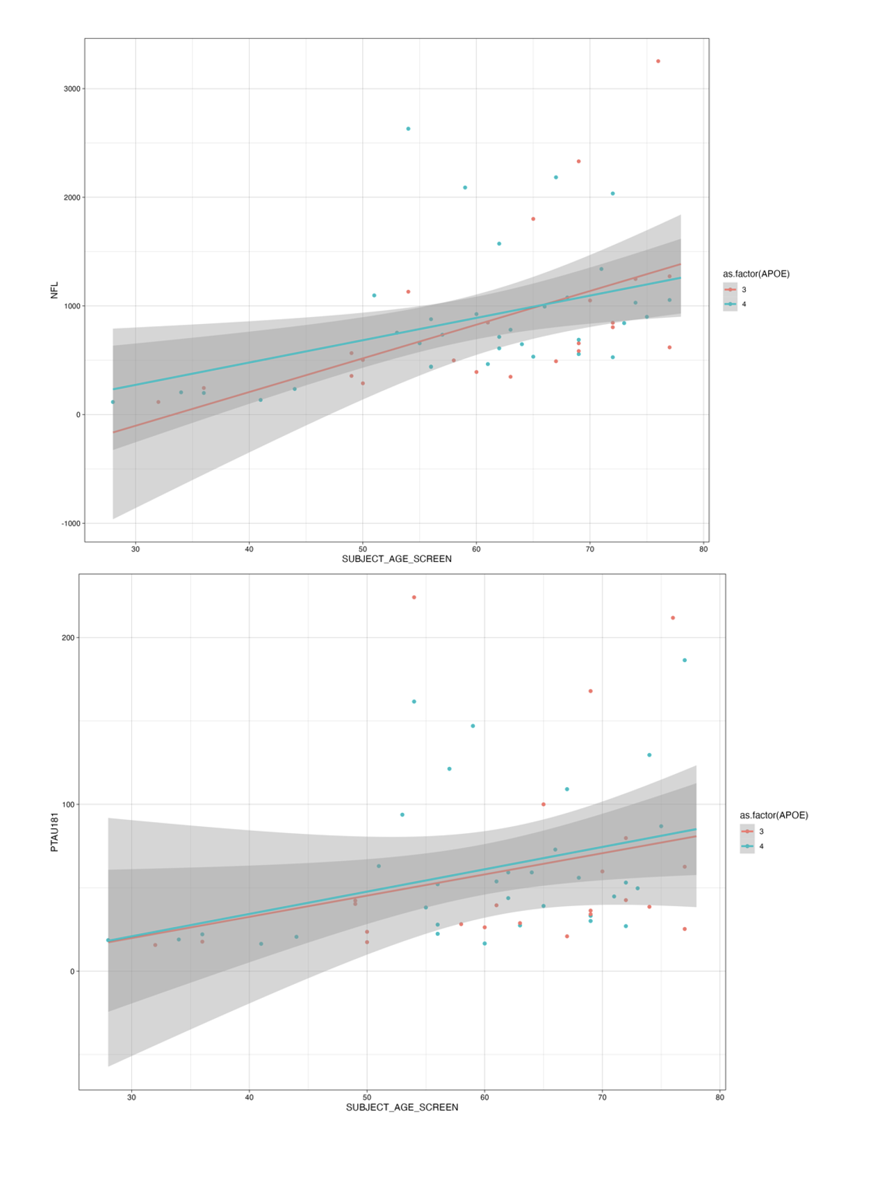
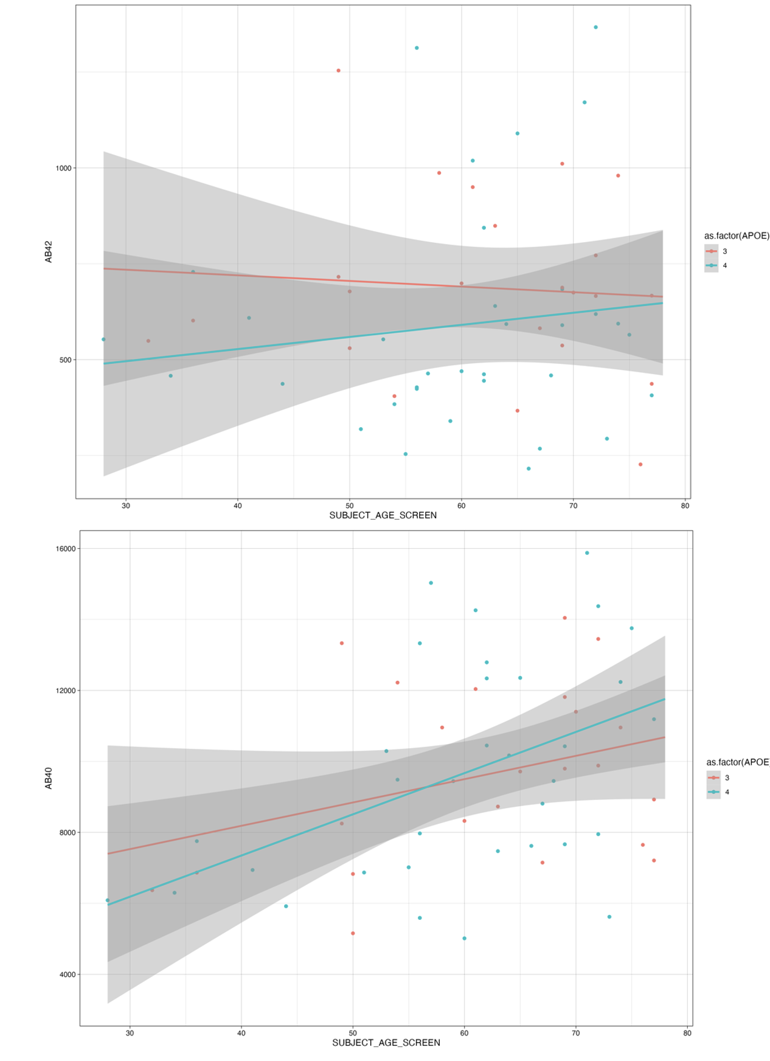
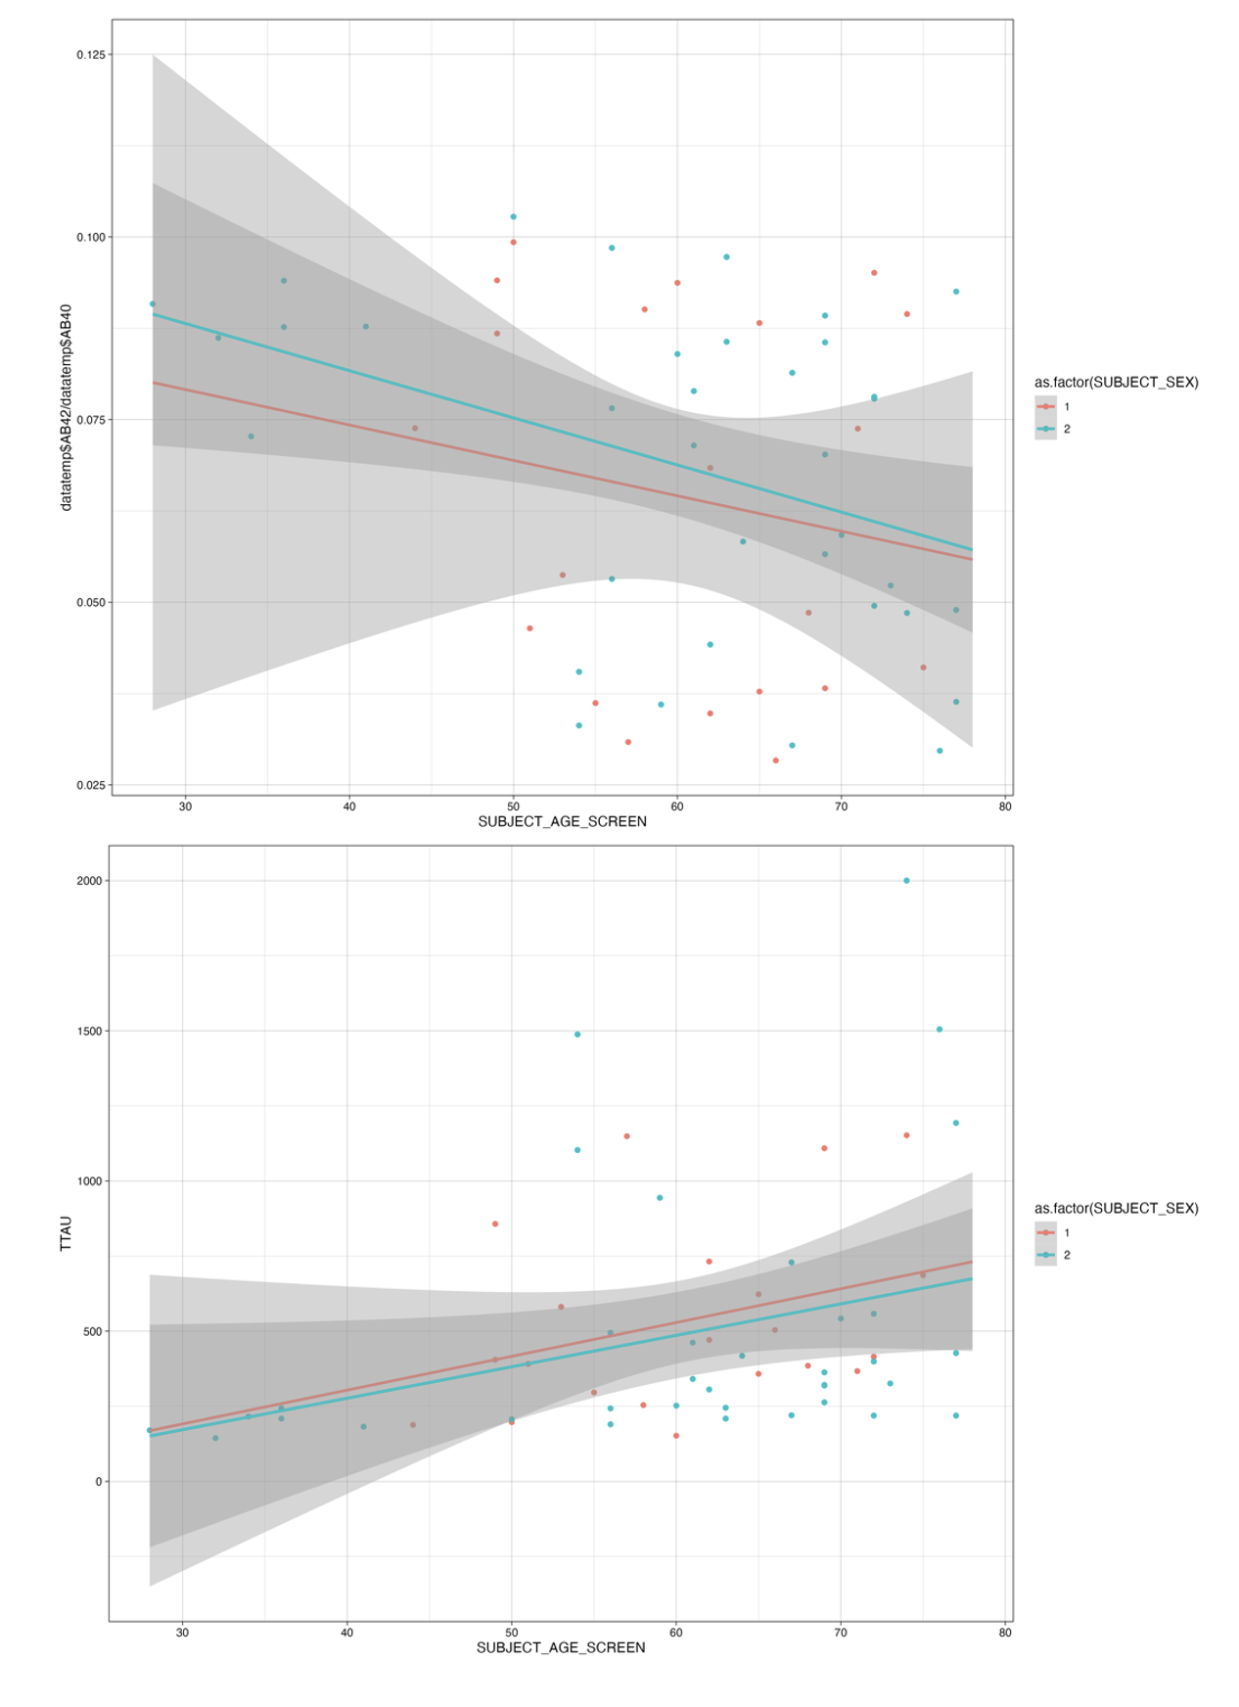
Biomarkers

Slide 8
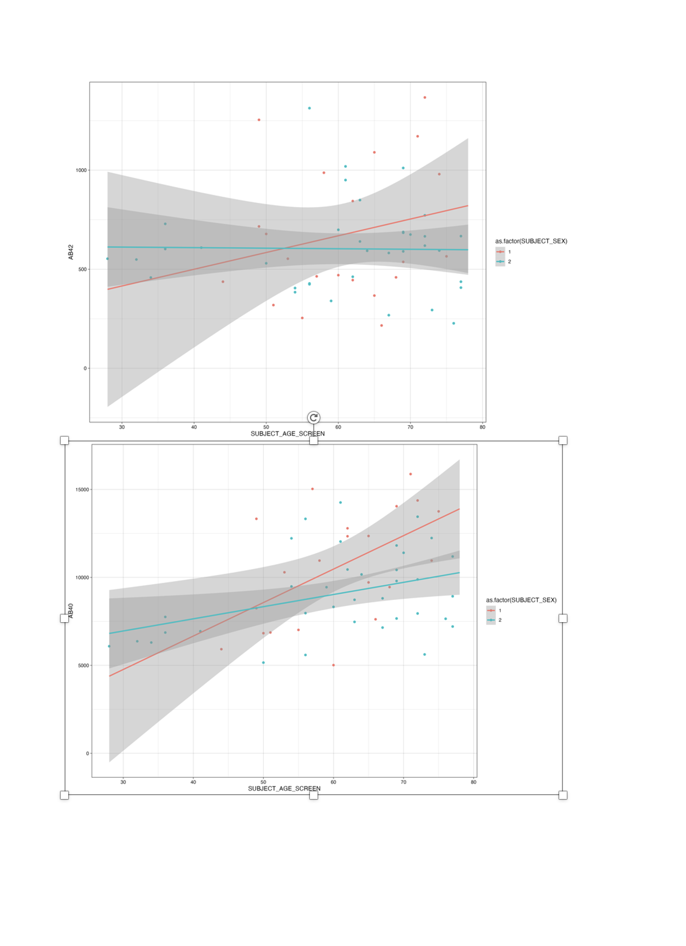
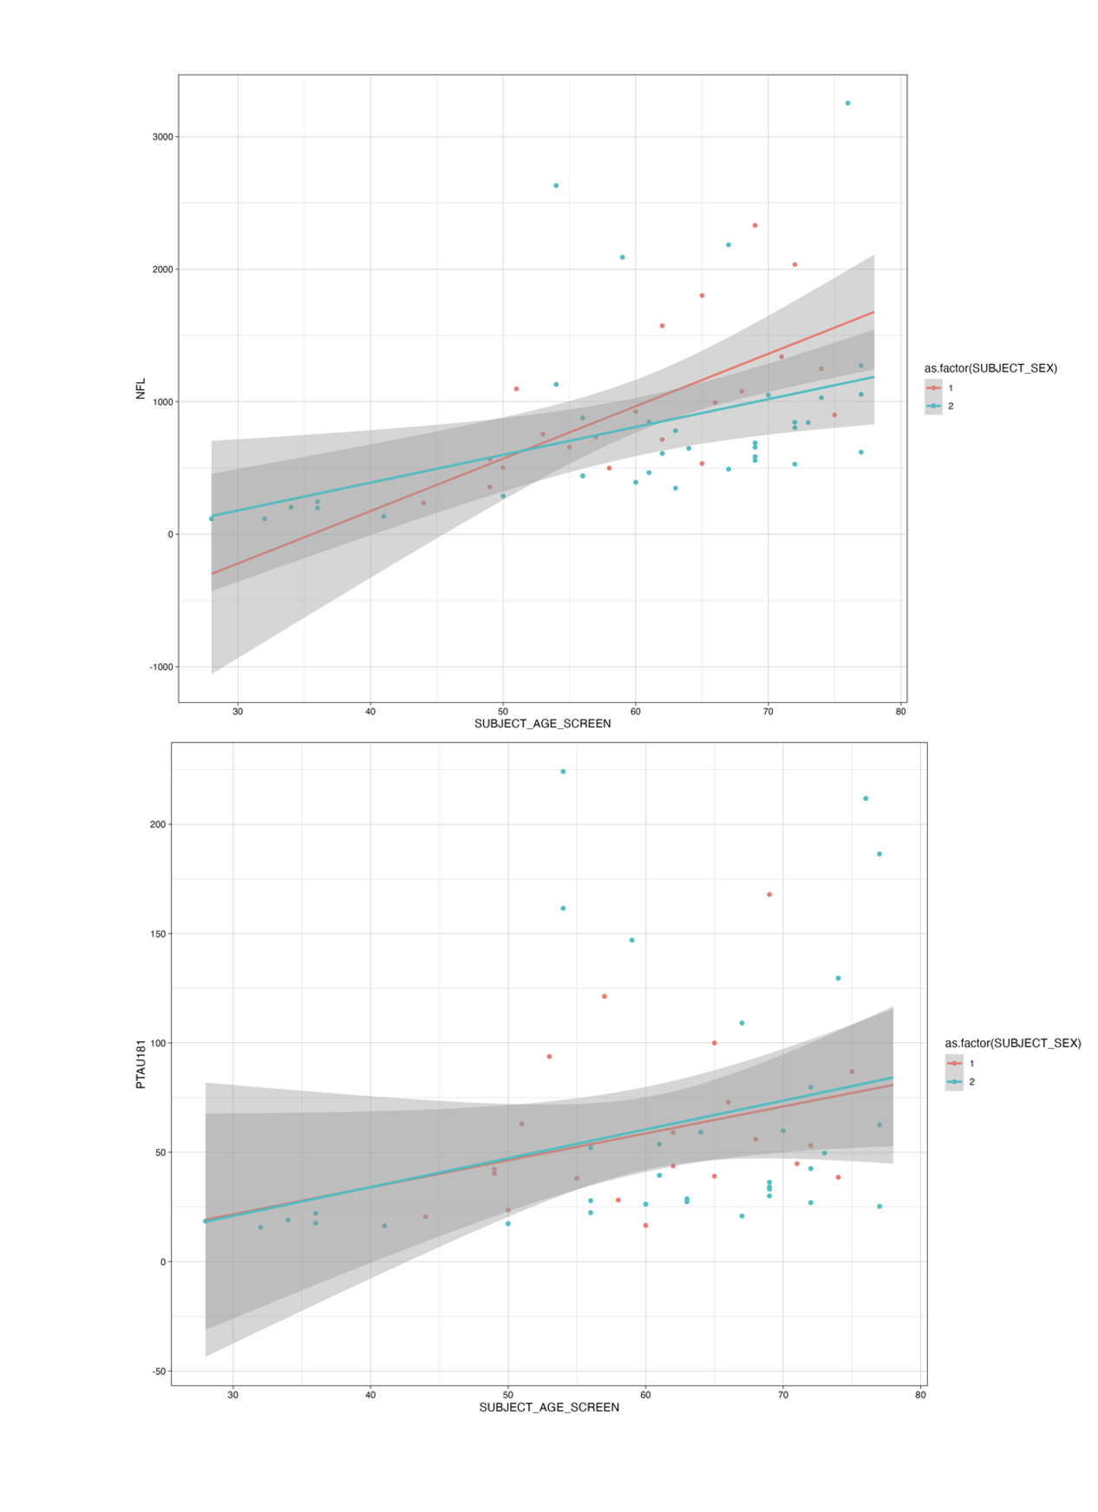

Slide 9
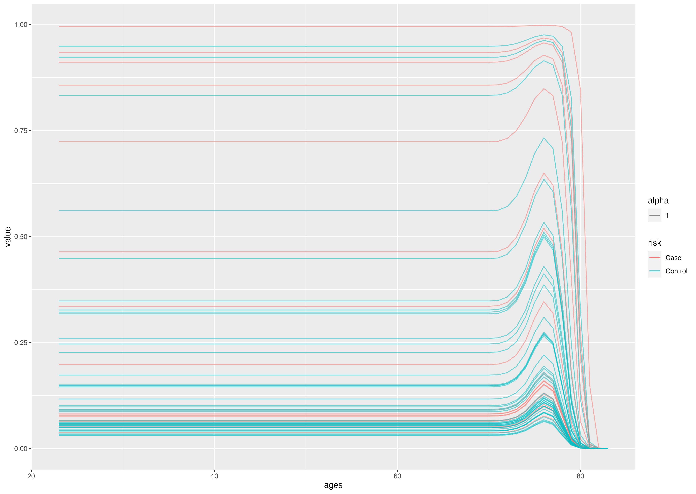
Adding biomarkers (TTAU, PTAU, Ab40, AB42, Abprop, NFL)

Slide 10
Regression to estimate any of the biomarker (mostly net becomes zero)
****** nothing much to show

